Slide 1
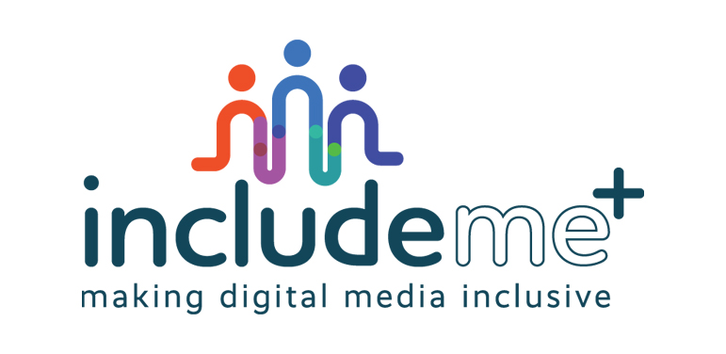

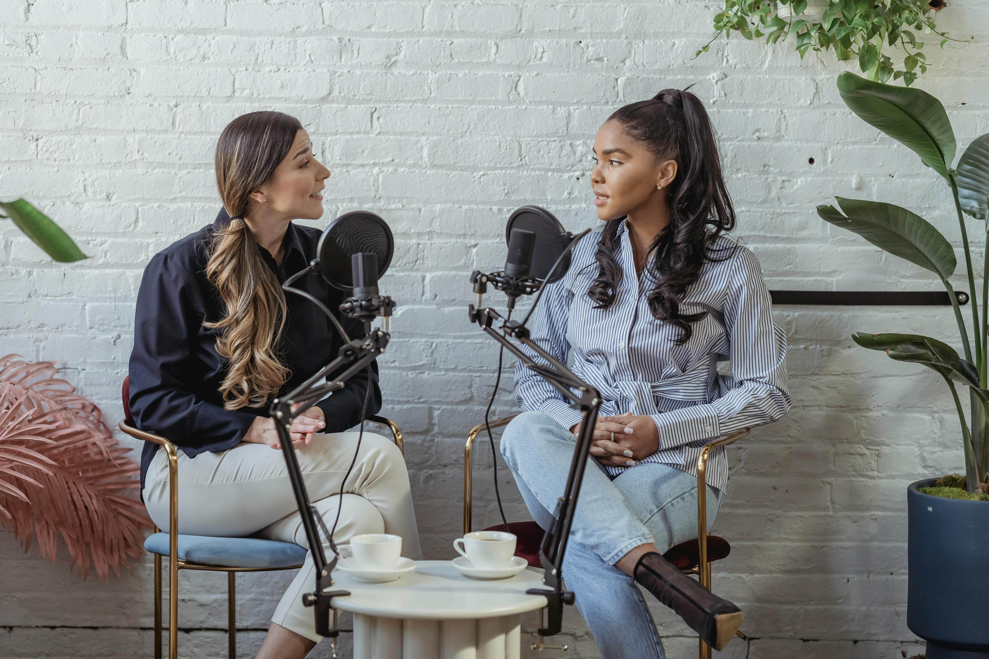


FREE Course: Dream Big. Act Bold. Create the Digital Future You Believe In.
What’s Inside!
7 Modules | 25+ Learning Areas | 30+ Case Studies
MODULE 1
MODULE 2
MODULE 3
MODULE 4
Introduction Foundations of Inclusive Digital Media: Mediation for a Connected Society
Removing Online Borders
Digital Media Narratives & Facilitating Cross-Border Dialogue
Bridging Divides
Using Digital Media to Bring People Together
How Media Builds Peace
Media’s Power in Peacebuilding and Social Cohesion
A practical starting point how digital mediation builds safe online spaces, tackles misinformation, and supports peacebuilding and mediation for all.
Module 1.
Understanding INCLUDE ME+ and Digital Mediation
The Need for Mediation in Digital Media Society & Key Stakeholders
Ethical Considerations in Digital Media: Balancing Free Speech and Inclusion
Explore how digital media shapes cross-border understanding, challenges stereotypes, and strengthens European identity.
Part 1.
Cross-Border Journalism and Storytelling: Uniting Diverse Perspectives
Part 2.
Digital Media’s Role in Addressing Misinformation in Political Discourse
Part 3.
Digital Media’s Representation of Migration and Multiculturalism
Part 4.
The Impact of Digital Media on Regional Identities
Learn how digital media reduces polarisation, tackles online hate, and builds safe, inclusive communities.
Part 1.
Digital Media and Community Building: Creating Inclusive Online Spaces
Social Media’s Role in Bridging Generational and Ideological Divides
Part 2.
Digital Diplomacy and Conflict Resolution: Strengthening Cross-Cultural Communication
Ethical Digital Engagement: Navigating Privacy, Bias, and Online Behaviour
Discover how digital media supports peacebuilding, reconciliation, and social cohesion through storytelling and citizen journalism.
Part 1.
Digital Media as a Tool for Post-Conflict Reconciliation in Europe
Part 2.
Storytelling for Social Change: Using Digital Media to Promote Peace Initiatives
Part 3.
European Digital Platforms Supporting Peace Journalism and Constructive Dialogue
Part 4.
The Role of Citizen Journalism in Strengthening Social Cohesion
Turn Your Digital Media Skills into a Force for Change!
Start our FREE course and learn how to shape inclusive, ethical, and peace-building digital spaces. This course takes you step by step through understanding, creating, and leading responsible media practices in Europe.
Discover how to spot misinformation, challenge polarisation, and strengthen social cohesion. Create powerful digital stories that unite communities across borders. Learn how to use media for peacebuilding, mediation, civic engagement, activism, and democratic participation.
MODULE 5
MODULE 6
MODULE 7
Speaking Up for Change
Active Voices: Digital Media as a Catalyst for Civic Engagement
Sharing Diverse Stories
Inclusive Storytelling: Amplifying Diverse Voices in the Digital Space
Ethics & Governance Together
Shared Responsibility: Citizens, CSOs, Media, and HEIs Shaping Ethical Digital Spaces
Discover how digital media drives activism, civic participation, and community mobilisation for social change.
Part 1.
Digital Activism in Europe: Opportunities and Challenges for Civic Participation
Part 2.
Using Social Media for Social Change: Best Practices and Ethical Considerations
Part 3.
Digital Participation and Engagement of Underrepresented Groups: Encouraging Democratic Involvement
Part 4.
Crowdsourcing and Digital Campaigning: Mobilising European Communities
Explore how digital storytelling amplifies diverse voices, preserves heritage, and challenges stereotypes.
Part 1.
Representation in Digital Media: The European Landscape of Diversity and Inclusion
The Power of the Digital Narrative: Challenging Stereotypes and Promoting Equity
Part 2.
Digital Storytelling for Social Changes: European Initiatives and Case Studies
Media and cultural heritage: preserving and showcasing Europe’s diverse stories
Learn how citizens, media, and educators can shape ethical, transparent, and inclusive digital spaces.
Part 1.
Ethical Journalism in the Digital Age: The Role of European Media Standards
Part 2.
Multi-Stakeholder Collaboration for Inclusive Digital Governance
Part 3.
Universities and Media Education: Strengthening Digital Citizenship in Europe
Part 4
The Role of Civil Society in Holding Digital Platforms Accountable
This resource is licensed under CC BY 4.0
Click here to access our Course
Funded by the European Union. Views and opinions expressed are however those of the author(s) only and do not necessarily reflect those of the European Union or the Finnish National Agency for Education. Neither the European Union nor the granting authority can be held responsible for them

