Slide 1

EDUCATORS' GUIDE
Digital Media for Inclusive Peacebuilding Course
www.includememedia.eu
* Note to manage waste please print this document in greyscale or black and white rather than in colour. Please print on both sides of the paper (duplex) and if you can print multiple slides or pages on one page.

Slide 2

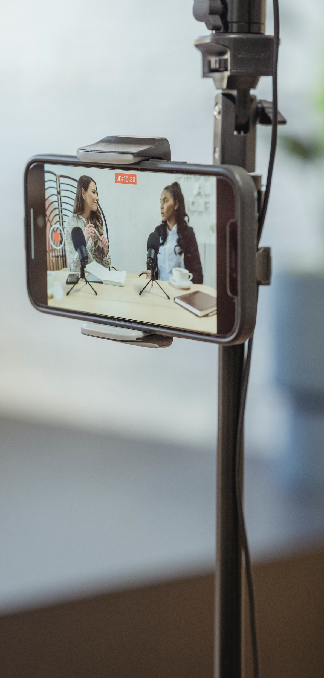

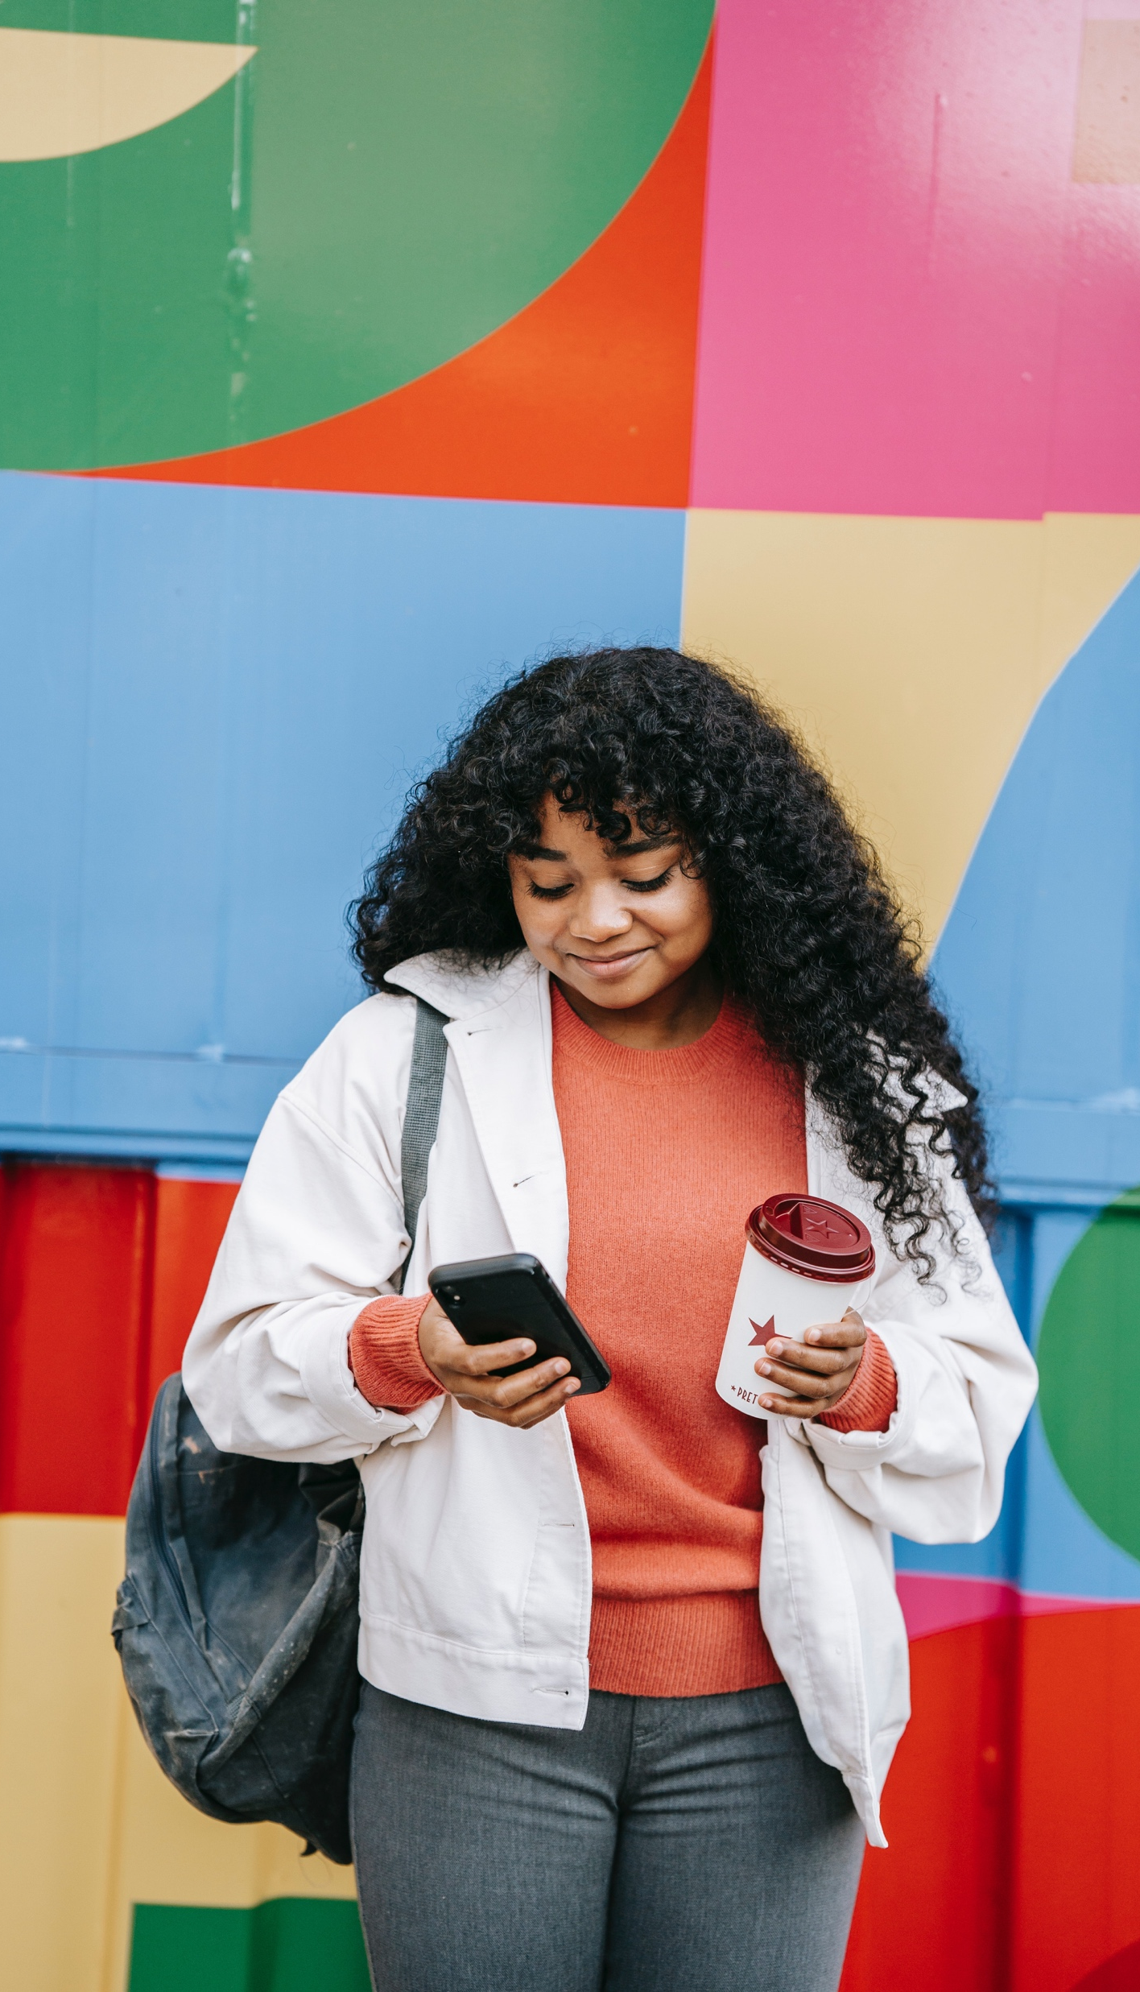


02
Page 4
Introduction
CONTENTS
01
03
Page 10
Page 3
Overview of the Curriculum
About the Project
04
Page 18
Delivery of the Curriculum

Slide 3

01
INCLUDE ME+
ABOUT THE PROJECT
INCLUDE ME+ responds to a recognised need to strengthen digital media literacy and address harmful impacts of digital media within communities - particularly in contexts shaped by crises, conflict, and societal polarisation. The project aims to support a vision of digital media as a tool for inclusion, social justice, and peacebuilding, by empowering higher education educators, digital media actors, civil society organisations, and students to become responsible and active contributors to the digital public sphere.
Objectives
Enhanced Digital Literacy & Critical Thinking – Equipping educators, students, and media professionals with the skills to navigate digital spaces responsibly.
Stronger Social Cohesion & Inclusion – Promoting diversity, reducing digital inequalities, and addressing online polarisation.
Empowered Stakeholders – Providing civil society organisations (CSOs), higher education institutions (HEIs), and media providers with tools for ethical and inclusive digital discourse.
Responsible & Ethical Digital Media Practices – Encouraging collaborative digital storytelling, peace journalism, and participatory media approaches.
Increased Civic Participation – Leveraging digital platforms for democratic engagement and active citizenship.
Policy & Institutional Change – Informing EU-wide strategies for inclusive digital media and digital rights advocacy.
Project partners
Åbo Akademi University (FI) https://www.abo.fi/en/
EUCEN (BE) https://eucen.eu/
Fundació Solidaritat UB (ES) https://www.solidaritat.ub.edu/
Momentum (IE) https://momentumconsulting.ie/
International European University (UA) https://ieu.edu.ua/en/
Outside (DE) https://outsidemedia.eu/
Tuzla District Governorship (TR) https://www.tuzla.gov.tr/
European E‑Learning Institute / EUEI (DK) https://www.euei.dk/

Slide 4

02
INTRODUCTION
Purpose of this
Teacher & Training Guide
This guide supports trainers and educators in delivering the IncludeMe+ course “Digital Media for Inclusive Peacebuilding” in flexible and transferable formats. It provides:
1) a clear overview of the 7‑module curriculum and how modules connect;
2) concise learning outcomes, key concepts, suggested activities, and assessment tasks for each module;
3) delivery format options;
4) quality guidance: inclusive facilitation, accessibility, evaluation, and ethical safeguards.
How to use this guide
This guide is designed to be practical rather than exhaustive, following the common Erasmus+ “training and transferability” guide pattern: overview → delivery options → methodologies → delivery format options.
The curriculum is Open Educational Resources (OER). UNESCO defines OER as learning/teaching materials in any format that are in the public domain or released under an open license permitting no‑cost access, reuse, adaptation, and redistribution. IncludeMe+ modules are published to support this reuse and transfer across learning settings.
Purpose of the Curriculum
The general purpose of the Digital Media for Inclusive Peacebuilding Curriculum is to provide practical guidance and ready-to-use training materials for educators, trainers, media professionals, and civil society actors. The curriculum supports the development of competencies related to inclusive communication, digital media literacy, and peacebuilding in diverse social contexts.
The curriculum is composed of a set of open educational resources (OERs) designed primarily for higher education teachers, lecturers, and trainers. All materials are openly accessible online and can be freely used, adapted, and integrated into different educational settings.
The modules are designed to be flexible and can be delivered in various formats, including face-to-face, fully online, blended learning, or self-paced modes, depending on the needs of learners, learning outcomes, and competence levels.
The curriculum and its associated materials aim to enable educators to effectively deliver training to students, media practitioners, and representatives of civil society organisations. All necessary resources are provided to support implementation in a wide range of educational and training environments.

Slide 5


Objectives
The curriculum is designed to achieve the following objectives:
➢ To promote an innovative and sustainable approach to education in the field of digital media and inclusive peacebuilding.
➢ To equip educators and trainers with relevant knowledge, skills, and pedagogical tools for delivering training on mediation, inclusion, and responsible digital communication.
➢ To support learners in understanding and critically analysing the role of digital media in conflict, misinformation, and peacebuilding processes.
➢ To enhance participants’ ability to create inclusive, ethical, and responsible digital media content.
➢ To foster collaboration between higher education institutions, media professionals, and civil society organisations.
Heading
Adaptability and Transferability
Educators and trainers can easily adapt the training materials to their specific context and target groups. The curriculum content has been developed and tested within the partnership framework and is designed to be transferable across different countries, institutions, and learning environments.
The flexible structure of the modules allows trainers to select, combine, and adjust content in order to design tailored training sessions using high-quality, practice-oriented materials.
ading
Click to type
.

Slide 6
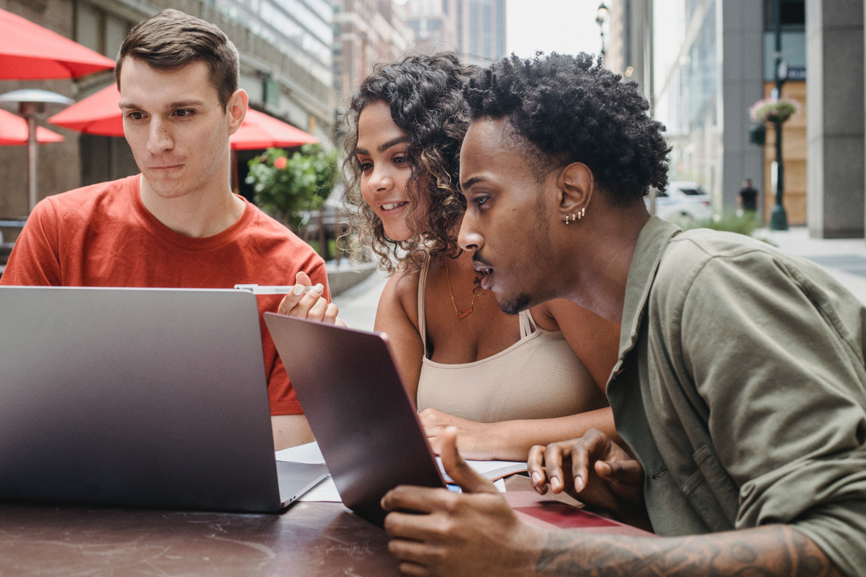
Learning Outcomes
The modules included in the curriculum will provide learners with knowledge and skills related to:
➢ Understanding the role of digital media in shaping public discourse, conflict dynamics, and peacebuilding processes.
➢ Identifying and critically analysing misinformation and disinformation in digital environments, including their impact on individuals and communities.
➢ Applying inclusive and participatory approaches in digital communication, ensuring diverse voices and perspectives are represented.
➢ Developing responsible, ethical, and conflict-sensitive digital media content.
➢ Enhancing digital media literacy and critical thinking skills in relation to online information and narratives.
➢ Promoting dialogue, mediation, and peaceful interaction through digital platforms and media tools.
➢ Strengthening collaboration between media professionals, educators, and civil society actors in fostering inclusive communication practices.
➢ Understanding the social and cultural dimensions of communication and applying intercultural sensitivity in digital media contexts.
/

Slide 7

The modules developed within the Digital Media for Inclusive Peacebuilding Curriculum are designed to be flexible and adaptable. They can be downloaded, modified, shortened, combined, or integrated into existing or newly developed courses and training programmes.
IncludeMe+ positions the course as a practical learning experience with “real-world strategies,” interactive resources, tools/templates, reflection prompts, and case studies. Trainers should design sessions around short inputs and high learner participation.
All materials are provided as open educational resources (OERs). When adapting the content, trainers are kindly requested to retain the project branding and acknowledge the source in accordance with copyright and dissemination requirements.
General Instructions
The modules are suitable for different learning environments and can be delivered using a variety of formats. For participants with limited access to technology, materials can be printed or accessed via mobile devices to ensure inclusivity and accessibility.
Trainers are encouraged to consider the following when delivering the curriculum:
➢ Adapt the content to the local context by incorporating relevant case studies, especially related to digital media, misinformation, and peacebuilding in the specific region.
➢ Encourage active participation by facilitating discussions, group work, and reflection on real-life digital media examples.
➢ Allocate sufficient time for interactive activities and critical discussions, particularly when addressing sensitive topics such as conflict, inclusion, and disinformation.
➢ Integrate regular reflection moments to support learners in connecting theoretical concepts with their own experiences and practices.
➢ Foster a safe, inclusive, and respectful learning environment where diverse perspectives can be expressed and discussed openly.

Slide 8
Trainer preparation checklist (minimum)
Review selected module pack(s) and choose 1- 2 core activities aligned with outcomes.
Prepare inclusive facilitation: roles (moderator/timekeeper), clear discussion rules, and conflict‑sensitive handling of polarising topics.
Run a short pre‑diagnostic (5 - 10 questions) to calibrate language level and media literacy baseline.
Ensure accessibility: captions/alt text, readable slides, multiple ways to participate.
Confirm data protection approach for registration, recordings, and student work sharing (GDPR where applicable).
Resources Required for Delivering the Curriculum
The resources required for delivering the curriculum will depend on the delivery format, available infrastructure, and the specific needs of learners.
At a minimum, the following is recommended:
· A computer, laptop, or mobile device with internet access
· Access to the online course materials and modules
· A comfortable learning environment with appropriate seating and workspace
Additional resources that can enhance the learning experience include:
· Projector, screen, or television for presentations and video materials
· Whiteboard or flipchart with markers for group work and discussions
· Printed materials (handouts, worksheets) where needed
· Headphones or earphones for individual online activities
Access to digital tools or platforms for collaboration (e.g. shared documents, discussion platforms)
Learning environment and technology
For online delivery, use a stable video conferencing tool and a Learning Management System (LMS) such as Microsoft Teams to host materials, assignments, and communication - consistent with typical Erasmus+ implementation guidance for online formats.
Trainers should adapt the use of resources according to the learning context, ensuring that all participants can engage effectively regardless of their level of digital access.

Slide 9
ELEMENTS OF THE CURRICULUM
The Digital Media for Inclusive Peacebuilding Curriculum consists of a variety of educational components designed to support both theoretical understanding and practical application.
Presentation-based and structured training materials
The modules include structured learning content that introduce key concepts and frameworks. These materials can be adapted to different learning contexts.
Multimedia content
Videos and other digital media resources are used to illustrate concepts, present real-life examples, and support understanding of complex topics such as misinformation and digital conflict.
Interactive exercises
The curriculum incorporates activities that promote active participation, including discussions, group work, and analytical tasks.
Learning activities and resources
Learners engage with different types of content, such as articles, online materials, and media examples, to develop critical thinking and digital literacy skills.
Case studies
Real-life and contextualised case studies are used to explore key themes, including misinformation, inclusion, and peacebuilding in digital environments.

Slide 10

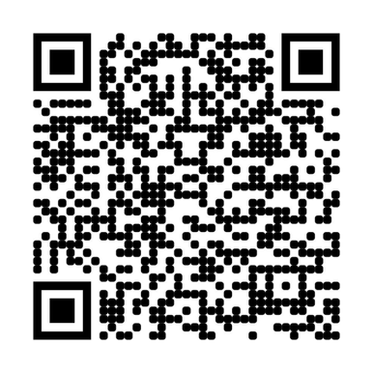
03
OVERVIEW OF CURRICULUM CONTENT
The IncludeMe+ course is presented as seven modules, each with downloadable materials and rich learning resources (interactive videos/case studies, digital tools/templates, exercises/reflection prompts, and research/guides for deeper learning)
https://includememedia.eu/digital-media-for-inclusive-peacebuilding-course/
Sections of the Modules
Each module within the Digital Media for Inclusive Peacebuilding Curriculum follows a consistent and structured format to support effective learning and ease of delivery. The modules are designed to combine theoretical knowledge with practical application and reflection.
Each module typically includes the following sections:
• Module Introduction
• Learning Objectives
• Key Concepts and Theoretical Background
• Core Content
• Case Studies and Examples
• Interactive Activities and Exercises
• Reflection and Discussion
• Additional Resources
• Assessment or Self-evaluation (optional)

Slide 11
MODULE 1
Foundations of Inclusive Digital Media: Mediation for a Connected Society
Overview | This module introduces the fundamental concepts of inclusive digital media and its role in shaping communication, participation, and social interaction in contemporary digital environments. It explores how digital media can both include and exclude individuals and groups, and highlights the importance of accessibility, representation, and diversity in media practices. The module also provides a foundation for understanding how inclusive approaches to digital media can contribute to dialogue, mutual understanding, and peacebuilding. Learners are encouraged to critically reflect on their own media use and the broader impact of digital communication in society.
Learning Objectives | By the end of this module, learners will be able to: Understand the concept of inclusive digital media and its key principles. Identify barriers to inclusion in digital communication and media environments. Analyse how digital media can influence participation, representation, and social inclusion. Recognise the importance of diversity, accessibility, and ethical considerations in media content. Reflect on their own role as digital media users and content creators.
Topics Covered | Definition and principles of inclusive digital media Digital inclusion and exclusion in online environments Representation and diversity in digital content Accessibility and participation in digital communication Ethical considerations in digital media The role of digital media in fostering dialogue and social cohesion
Suggested Learning Activities | Group Discussion: Discuss examples of inclusive and non-inclusive digital media. What makes content accessible or exclusionary? Case Study Analysis: Analyse real-life examples of digital media campaigns or platforms and evaluate their level of inclusivity. Media Reflection Exercise: Ask learners to reflect on their own social media use and identify how inclusive their communication practices are. Content Evaluation Task: Provide different types of digital content (posts, videos, articles) and ask learners to assess them using inclusion criteria. Mini Project: Learners create a short piece of digital content (e.g. post, video concept, campaign idea) that promotes inclusion and diversity.

Slide 12

/
MODULE 2
Digital Media Narratives & Facilitating Cross-Border Dialogue
Overview | This module explores how digital media shapes narratives across borders and influences intercultural understanding in a connected and diverse Europe. It focuses on the role of media in representing identities, migration, and multiculturalism, as well as its impact on public discourse and democratic processes. Learners examine how digital storytelling, journalism, and media platforms can either reinforce divisions or promote dialogue, empathy, and cooperation. The module highlights the importance of ethical media practices, critical media literacy, and inclusive storytelling in addressing misinformation, challenging stereotypes, and fostering social cohesion. Using real-world examples and case studies, the module encourages learners to analyse media narratives and reflect on how digital media can contribute to a more inclusive and interconnected society.
Learning Objectives | By the end of this module, learners will be able to: Understand how digital media influences regional narratives and intercultural dialogue. Analyse the role of cross-border journalism and storytelling in promoting mutual understanding. Identify and critically evaluate misinformation and its impact on political discourse. Assess how migration and multiculturalism are represented in digital media. Reflect on the role of media in shaping regional identities and European integration. Apply inclusive and ethical media practices in content creation and communication.
Topics Covered | Cross-Border Journalism and Storytelling Misinformation in Political Discourse Media Representation of Migration and Multiculturalism Digital Media and Regional Identities
Suggested Learning Activities | Case Study Analysis: Learners analyse real-life examples of cross-border journalism, misinformation, or media representation and discuss their societal impact. Media Content Analysis Exercise: Students evaluate news articles or social media content to identify narratives, biases, and framing techniques. Group Discussion: Facilitated discussions on how digital media influences perceptions of migration, identity, and cultural diversity. Misinformation Detection Task: Learners identify examples of misinformation and explore tools and strategies used to counter it. Storytelling Workshop: Participants create their own inclusive digital stories or campaigns that promote dialogue and diversity. Reflection Activity: Learners reflect on their own media consumption habits and how these influence their understanding of different communities.
/

Slide 13
MODULE 3
Using Digital Media to Bring People Together
/
Overview | This module explores how digital media can be used as a tool to foster connection, dialogue, and cooperation among diverse communities. It focuses on the role of digital platforms in bridging social, cultural, and political divides, while also addressing the challenges of polarisation, exclusion, and harmful online interactions. The module introduces the concept of inclusive online spaces and examines how ethical communication and digital diplomacy can support constructive engagement in digital environments. Learners are encouraged to reflect on how digital media can be used to promote mutual understanding, trust, and peaceful interaction. Through practical examples and case studies, the module highlights how responsible and inclusive digital communication can contribute to peacebuilding and stronger, more connected communities.
Learning Objectives | By the end of this module, learners will be able to: Understand how digital media can be used to connect people and foster inclusive dialogue. Identify barriers to participation and inclusion in digital spaces. Apply principles of ethical and respectful communication in online environments. Analyse the role of digital diplomacy in promoting cooperation and understanding. Develop strategies for creating inclusive and safe online communities. Reflect on their own role in shaping digital interactions and communication.
Topics Covered | Inclusive online spaces and digital participation Barriers to inclusion and digital divides Ethical communication in digital environments Digital diplomacy and responsible engagement Online dialogue and conflict-sensitive communication Building trust and fostering cooperation through digital media
Suggested Learning Activities | Case Study Analysis: Analyse examples of online communities or campaigns that successfully bring people together, as well as cases where digital media contributes to division. Online Interaction Simulation: Learners participate in a structured online discussion, applying inclusive and respectful communication practices. Ethical Scenario Exercise: Discuss real-life digital communication dilemmas (e.g. hate speech, polarisation, misinformation) and explore appropriate responses. Group Discussion: Reflect on how digital media can both connect and divide communities. Digital Campaign Task: Learners design a digital initiative aimed at promoting dialogue, inclusion, or community engagement. Self-reflection Activity: Participants analyse their own online behaviour and identify ways to communicate more inclusively and constructively.
/
/

Slide 14
Module 4
Building Digital Bridges: Media’s Power in Peacebuilding and Social Cohesion
Overview | This module explores how digital media can be used as a powerful tool for peacebuilding, conflict prevention, and social change. It focuses on the role of digital storytelling, journalism, and online platforms in promoting dialogue, reconciliation, and social cohesion in post-conflict and diverse societies. The module examines how media can contribute both positively and negatively to conflict dynamics, highlighting the importance of responsible communication, ethical storytelling, and peace-oriented journalism. Learners are introduced to practical approaches for using digital media to amplify voices, raise awareness, and support inclusive narratives. Through real-world examples and case studies, the module demonstrates how digital media initiatives can foster understanding, empower communities, and contribute to long-term peacebuilding efforts.
Learning Objectives | By the end of this module, learners will be able to: Understand the role of digital media in peacebuilding, conflict prevention, and social change. Analyse how media narratives can influence conflict dynamics and public perception. Apply storytelling techniques to promote inclusive and peace-oriented narratives. Identify and evaluate platforms and tools that support peace journalism and digital activism. Develop strategies for using digital media to support dialogue, reconciliation, and social cohesion. Reflect on ethical considerations in media production in sensitive or conflict-related contexts.
Topics Covered | Digital media as a tool for post-conflict reconciliation Digital storytelling for social change Platforms supporting peace journalism Social media and its role in conflict prevention Citizen journalism and digital activism Ethical storytelling and responsible media practices
Suggested Learning Activities | Case Study Analysis: Analyse real-world examples of digital media initiatives used in peacebuilding or social change contexts. Storytelling Workshop: Learners create a digital story, campaign concept, or narrative that promotes inclusion, dialogue, or reconciliation. Media Analysis Exercise: Evaluate media coverage of a conflict or social issue and identify elements that either escalate or de-escalate tensions. Group Discussion: Discuss the role of social media and citizen journalism in shaping public understanding of conflicts. Platform Exploration Task: Explore digital platforms that support peace journalism and analyse their impact and effectiveness. Reflection Activity: Learners reflect on the ethical responsibilities of media creators when addressing sensitive topics such as conflict and social injustice.

Slide 15
Module 5
Active Voices: Digital Media as a Catalyst for Civic Engagement
Overview | This module explores how digital media can enhance civic participation and empower individuals—especially underrepresented groups—to engage in democratic processes and social change. It focuses on the role of digital activism, social media, and online platforms in mobilising communities, shaping public discourse, and encouraging active citizenship. The module examines both the opportunities and challenges of digital engagement, including issues such as misinformation, data privacy, and ethical participation. It highlights how digital tools and platforms can create inclusive spaces for dialogue, advocacy, and grassroots movements. Through practical examples and case studies from across Europe, learners gain insights into how digital media can support civic engagement, strengthen democratic participation, and amplify diverse voices in society
Learning Objectives | By the end of this module, learners will be able to: Understand how digital media contributes to civic engagement and democratic participation. Analyse the role of digital activism and social media in shaping political and social movements. Identify opportunities and barriers for the participation of underrepresented groups in digital spaces. Apply ethical principles in digital civic participation, including responsible communication and data awareness. Evaluate the impact of digital campaigns, online communities, and social movements. Develop strategies for using digital tools to promote inclusive and active citizenship.
Topics Covered | Digital activism in Europe: opportunities and challenges for civic participation Using social media for political engagement: best practices and ethical considerations Digital participation and engagement of underrepresented groups The role of digital media in strengthening civic dialogue and social movements Ethical challenges in digital participation (misinformation, privacy, algorithmic influence) Digital tools and platforms for civic engagement and community mobilisation
Suggested Learning Activities | Case Study Analysis: Analyse real-world examples such as digital activism campaigns or political movements (e.g., European elections, social movements, online advocacy initiatives). Digital Campaign Design: Learners design a small-scale digital campaign aimed at raising awareness or promoting civic participation on a chosen issue. Media and Platform Analysis: Evaluate how social media platforms are used for political engagement and identify both opportunities and risks (e.g., misinformation, polarisation). Group Discussion: Discuss the role of digital media in shaping civic dialogue and the challenges of ensuring ethical participation online. Inclusion Exercise: Explore how underrepresented voices can be amplified in digital spaces and identify barriers to participation. Reflection Activity: Learners develop personal guidelines for responsible and ethical digital participation (e.g., fact-checking, respectful communication). Tool Exploration Task: Explore digital tools and platforms that support civic engagement and assess their effectiveness.

Slide 16
Module 6
Inclusive Storytelling: Amplifying Diverse Voices in the Digital Space
Overview | This module explores how digital media can be used to amplify diverse voices, promote inclusion, and preserve cultural heritage through storytelling. It examines representation and equity in digital media, the role of storytelling in challenging stereotypes, and the power of participatory narratives in driving social change. The module also highlights how digital tools and platforms support cultural preservation and community-led storytelling while addressing ethical considerations and issues of access and ownership.
Learning Objectives | By the end of this module, learners will be able to: Analyse representation, diversity, and inclusion in digital media contexts. Evaluate how digital storytelling contributes to social change and civic engagement. Apply participatory storytelling approaches to empower marginalised communities. Design inclusive and ethical digital narratives that challenge stereotypes. Understand and utilise digital tools for preserving and promoting cultural heritage. Assess the impact of digital storytelling through engagement, feedback, and policy influence.
Topics Covered | Representation in Digital Media Power of Digital Narratives Digital Storytelling for Social Change Media and Cultural Heritage
Suggested Learning Activities | Case study analysis: Examine digital storytelling campaigns (e.g., Roma Stories, Stories for Change) and evaluate their impact. Campaign design task: Create a small-scale social media campaign addressing a social issue using inclusive storytelling principles. Podcast or storytelling project: Record and share a community-based story highlighting cultural heritage or lived experiences. Group discussions: Reflect on ethical issues in storytelling, representation, and cultural ownership. Digital tools practice: Use platforms (e.g., Datawrapper) to create visual storytelling content. Impact evaluation exercise: Analyse engagement metrics and assess the effectiveness of storytelling initiatives.

Slide 17
Module 7
Making the Internet a Safer, Fairer, & Honest Space
Overview | This module explores ethical challenges and governance in the digital media landscape, focusing on how media professionals, universities, policymakers, and civil society contribute to creating a safer, fairer, and more transparent digital environment. It highlights the importance of media literacy, ethical journalism, multi-stakeholder collaboration, and accountability mechanisms in strengthening digital citizenship and combating misinformation.
Learning Objectives | By the end of this module, learners will be able to: Analyse the role of ethical journalism and European media standards in combating misinformation Evaluate challenges related to credibility, transparency, and trust in digital media Understand how multi-stakeholder collaboration shapes inclusive digital governance Explore the role of universities in promoting media literacy and digital citizenship Assess how civil society organisations hold digital platforms accountable Develop critical thinking skills for responsible participation in digital environments
Topics Covered | Ethical Journalism in the Digital Age Inclusive Digital Governance Universities and Media Literacy Civil Society and Platform Accountability
Suggested Learning Activities | Case Study Analysis: Examine how universities promote media literacy and critical thinking (e.g., Tampere University case) Research Reflection: Analyse academic studies on misinformation and discuss their real-world implications Group Discussion: Debate ethical dilemmas in digital journalism and platform governance Practical Exercise: Apply fact-checking frameworks (e.g., CRAAP, PARCS) to evaluate online content Simulation Activity: Create digital content following ethical journalism principles Policy Workshop: Design a collaborative governance model involving different stakeholders Media Literacy Campaign: Develop a small awareness campaign addressing misinformation

Slide 18

04
The curriculum has been designed to ensure flexibility, accessibility, and transferability across diverse educational contexts.
It can be delivered in both online and face-to-face settings, as well as through blended learning approaches, depending on institutional capacities and learners’ needs.
OPTIONS FOR DELIVERING THE CURRICULUM
The curriculum may be delivered through the following formats:
FACE-TO-FACE DELIVERY
ONLINE FORMAT

Slide 19

FACE-TO-FACE DELIVERY
The curriculum can be delivered in a traditional face-to-face format within classroom or training settings. This approach supports direct interaction between educators and learners and fosters collaborative and experiential learning.
Training materials, including presentations, case studies, and exercises, can be used during in-person sessions to facilitate discussions, group work, and practical activities. This format is particularly suitable for workshops, seminars, and formal education programmes.
When delivering the curriculum in a face-to-face format, consider the following:
➢ Create an inclusive and participatory learning environment that encourages dialogue and peer learning.
➢ Use interactive teaching methods such as group discussions, role-plays, and problem-solving activities.
➢ Incorporate case studies and real-life examples to support practical understanding.
➢ Encourage collaborative work through group tasks and project-based learning.
➢ Adapt materials and activities to different learning styles and levels of prior knowledge.
➢ Provide opportunities for reflection and feedback during and after sessions.
➢ Ensure accessibility and inclusivity for all learners.
This format enables immediate feedback, active engagement, and the development of communication and teamwork skills, contributing to a more dynamic and interactive learning experience.

Slide 20

ONLINE FORMAT
The online delivery of the curriculum provides a fully digital learning experience that can be accessed from anywhere, at any time. This approach utilises digital tools and platforms to support flexible and inclusive learning.
The training materials are available in digital format and include presentations, videos, case studies, and interactive exercises. These resources can be accessed independently or as part of facilitated online sessions, allowing learners to engage with the content at their own pace.
When delivering the curriculum remotely, consider the following:
➢ Ensure that learners have access to stable internet connection and appropriate digital devices (e.g. laptop, tablet, headset).
➢ Use a Learning Management System (LMS) such as Moodle, Google Classroom, or Microsoft Teams to organise content, assignments, and communication.
➢ Combine synchronous learning (live sessions via Zoom or Teams) with asynchronous learning (recorded materials, readings, and exercises).
➢ Integrate interactive tools (e.g. Mentimeter, Padlet, Kahoot) to enhance engagement and participation.
➢ Provide opportunities for interaction through discussion forums, group work, and peer feedback.
➢ Offer regular support through virtual consultations or office hours.
➢ Include interactive elements in live sessions, such as breakout rooms, polls, and Q&A activities.
When selecting the delivery mode, educators and trainers are encouraged to consider the specific needs of learners, available technological and institutional resources, and the overall learning objectives. The Educator’s Guide supports this process by ensuring pedagogical coherence, inclusivity, and effective knowledge transfer across different implementation contexts.

Slide 21
Methodology rationale
IncludeMe+ modules consistently embed exercises, videos, tools, and case studies - indicating an instructional intent toward experiential learning rather than lecture-only delivery. The guide therefore recommends a methodology stack commonly used in Erasmus+ training resources: blended delivery, flipped elements, collaborative learning, peer review, and project-based outputs.
Teaching methodologies
Recommended core methodologies
Use 2 - 3 per session to keep pacing disciplined.
Case-based learning: Use module-provided European case studies to connect concepts to real practice and to make ethical dilemmas visible (e.g., misinformation cases; peace journalism initiatives; platform accountability examples).
Simulation and role-play: Especially effective for digital mediation (moderation/repair of dialogue), stakeholder governance, and civic debate. Module 1 explicitly points to role-playing, debate simulations, and fact-checking as interactive tools.
Collaborative learning and peer feedback: Build cross-sector perspective by intentionally mixing learners from HEIs, media, CSOs, and students - consistent with IncludeMe+ target groups and consortium training experiences.
Project-based learning (PBL): End modules with an artefact (charter, story prototype, campaign plan, governance proposal). The course’s “tools & templates” orientation supports PBL and portfolio assessment.
Reflective practice (guided prompts): Include reflection intervals across the course; many OER transferability guides highlight reflection as essential to deeper learning transfer.
This Educator’s Guide provides a structured and flexible framework for delivering the curriculum across a variety of educational contexts. By combining theoretical knowledge with practical activities, the programme supports the development of critical thinking, media literacy, and inclusive digital communication skills.
The curriculum encourages educators and learners to actively engage with digital media in a responsible, ethical, and inclusive way. Through its modular structure and adaptable format, it can be integrated into formal education, non-formal training, and lifelong learning initiatives.
This programme aims to contribute to the creation of more inclusive, informed, and resilient digital societies by empowering individuals to participate critically and constructively in the digital space.

Slide 22


* Note to manage waste please print this document in greyscale or black
and white rather than in colour. Please print on both sides of the paper
(duplex) and if you can print multiple slides or pages on one page.​
www.includememedia.eu
* Note to manage waste please print this document in greyscale or black and white rather than in colour. Please print on both sides of the paper (duplex) and if you can print multiple slides or pages on one page.

